Slide 1
Using the rpc data center

Slide 2
Metrics
Outcome Measure: NTSV cesarean rate
Balancing Measure: Apgars less than 7 at 5 min.
Variables for all NTSV patients: 13
Variables per bundle: 4-7

Slide 3
Before Data Collection Begins:
Before data collection begins, have an Information Technology Specialist at your hospital ensure :
the monthly data collection spreadsheet is located in a secure location on your network, accessible to all the individuals who will be using it.
a current version of Microsoft Excel is installed at the workstations that will be used to input the data.

Slide 4
The RN and/or CNM/MD who attended the delivery should do the following:
After Every Delivery:
Step 1: Determine if the patient case was NTSV:
Nulliparous (no prior pregnancies beyond 20 weeks)
Term (37+0 weeks gestational age)
Singleton
Vertex presentation

Slide 5
Step 2 Open the spreadsheet

Slide 6
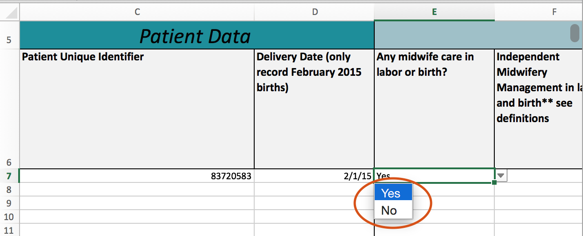
Step 3: Answer using drop down
Step 3: Answer all the questions from left to right using the available drop-down options. Please DO NOT populate any of the questions with manually typed responses.

