Slide 1
Healthy Birth Initiative®
Reducing Primary Cesareans Collaborative

Slide 2
Quality Improvement Capacity: PDSA
Diana R. Jolles CNM PhD (c) FACNM
Cathy Emeis CNM PhD
ACNM Quality Section

Slide 3
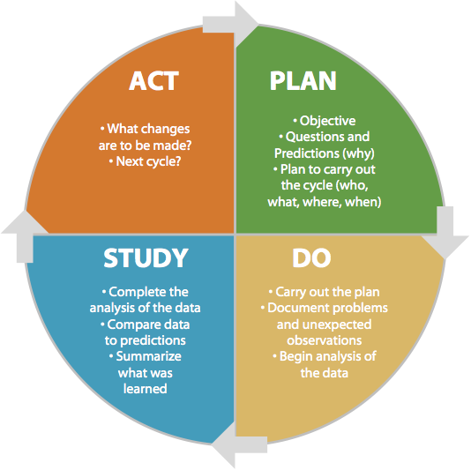

Slide 4
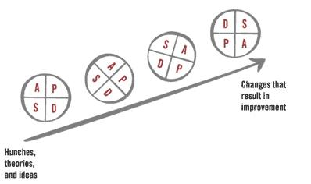
PDSA Cycles
Notes:
Iterative process
Multiple ramps

Slide 5
PDSA RAMPS
Notes:
Nixon ramps
Housetrain
Don’t get on couch
Don’t chew non-toys
Fetch

Slide 6
“Level One Care for All”

Slide 7
Align patient preferences with outcomes
Pilot: Pain relief intentions and Breastfeeding
Notes:
2005 66% of women who stated preference to “avoid epidural” achieved this goal.
Service line delivery innovation
Workforce innovation (add OOH midwives) as leaders of change
Increase supportive care in labor and EB physiologic birth practices
Account to family focused care (209 (12%) of 1,698 cases
Contained no note of intention.
Frequent documentation of
“refusing” pain medicine
After intention of patient was
clearly documented

Slide 8
PLAN
Intermittent Auscultation (IA) as standard of care for healthy, medically low risk childbearing women in spontaneous labor.
Use existent care guideline
Promote mission/aim
Train 100% of interprofessional staff
Model and mentor behavior
Measure % time admitted with exclusive IA , success with pain relief intention
Step 1:
Plan the test or observation, including a plan for collecting data.
Make predictions about what will happen and why.

Slide 9
DO
Over 2 week time period complete mandatory in-service all interprofessional staff, all shifts.
Increased awareness of guideline, research, safety, appropriate candidates.
Modeled behavior, night shift pilot.
Challenges: CNM/PT ratio, RN resistance, turn over, triage
Step 2: Do
Try out the test on a small scale.
Carry out the test.
Document problems and unexpected observations.
Begin analysis of the data.

Slide 10
STUDY
Time on Intermittent Auscultation
PRE- 1.6 %
POST- 35.6 %
(Benchmark 85.3)
P=<.001, OR 22.2
Achieve pain relief intention
PRE- 72.8%
POST-97.5%
(Benchmark 98.6%)
P=<.001, OR 10.8
Step 3: Set aside time to analyze the data and study the results. Complete the analysis of the data.
Compare the data to your predictions.
Summarize and reflect on what was learned.

Slide 11
ACT
CNM/pt ratio
Volunteer doulas
Expanded hours
Revised guidelines (all access, no order required, “care of the laboring patient”, “pain management guideline- inc. non-pharmacologic)
RN resistance
Continued reinforcement, capacity, skills building, documentation
MD leadership
Time
Turn over
Hardwired competency assessment
Hardwired surveys 2x/year (interprofessional)
Interprofessional performance evaluation (chart audits, self eval, peer eval)
Triage
Discharge
Step 4:
Refine the change, based on what was learned from the test.
Determine what modifications should be made.
Prepare a plan for the next test.

Slide 12
 | Denver Health 2005 N=269 | Denver Health 2010 N=1,065
Continuous labor support | 2% | 67%
Hydrotherapy | 3% | 61%
Intermittent auscultation | 2% | 67%
Intermittent auscultation only | 0% | 29%
Success with pain relief intention | 50% | 76%
Non-lithotomy birth position | 1% | 98%
Notes:
Just slightly over 80% qualified sample (low risk, spontaneous labor, preference for natural birth)

Slide 13
Participates in shared decision making regarding approaches to FHR assessment.

Slide 14
PLAN
On admission to L&D unit, all patients who are deemed eligible for IA will participate in decision making regarding their preference for ongoing FHR assessment in labor.
Step 1:
Plan the test or observation, including a plan for collecting data.
Make predictions about what will happen and why.

Slide 15
DO
Standard script for introducing options for FHR assessment in labor will be developed and utilized by admitting staff/provider.
Hypothesis: we predict women will choose IA more than 50% of the time after listening to a standard script that introduces options for FHR assessment.
Data collection begins that monitors number of minutes that staff/provider spend in discussion/answering questions about options for FHR assessment in labor; document patient’s choice.
Step 2: Do
Try out the test on a small scale.
Carry out the test.
Document problems and unexpected observations.
Begin analysis of the data.

Slide 16
STUDY
After 3 weeks, we found that 25% of women have chosen IA for FHR assessment in labor. Average time needed for discussion is 10 minutes. Several concerns found: difficult to have discussion when patient is uncomfortable; patients caught off guard that they would be invited to state their preference for type of assessment; several patients preferred staff/provider to choose method; several requested handout to read and consider.
Step 3: Set aside time to analyze the data and study the results. Complete the analysis of the data.
Compare the data to your predictions.
Summarize and reflect on what was learned.

Slide 17
ACT
Patient education handout developed for distribution to provider clinics for distribution in third trimester (translated into multiple languages); Meet with childbirth educators to discuss options for FHR assessment; Revise scripts based on lessons learned during cycle.
Begin next cycle of assessment after changes instituted.
Step 4:
Refine the change, based on what was learned from the test.
Determine what modifications should be made.
Prepare a plan for the next test.

Slide 19
Tips for Successful Linked Tests of Change ⁽²⁾
Plan multiple cycles for testing a change.
Think ahead through a couple of cycles.
Scale down the test size (the number of patients or location).
Test with volunteers.
Focus on getting consensus or buy-in from management, staff who will do the work, and patients and families.
Be innovative to make the test feasible.
Collect useful data during each test.
Test over a wide range of conditions.
Use a quick test; for example, ask "What change can we test by next Tuesday?"

