Slide 1
Tools for Performance Improvement
Sandra Hart, RN
Bronson

Slide 2
Fishbone – Cause and Effect

Slide 3
Fishbone – Cause and Effect

Slide 4
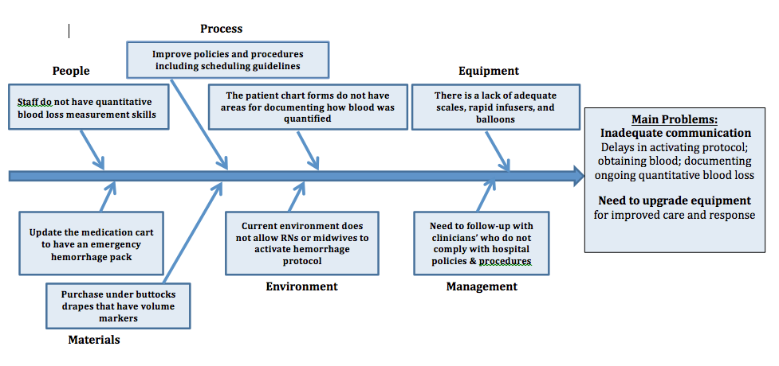
Sample Fishbone

Slide 5
5 Why’s Worksheet
Date:
Completed by:
Define the Problem:
Why is this happening?
Caution: try to answer without making assumptions, if possible.
1.
Why is
that?
2.
Why is
that?
3.
Why is
that?
4.
Why is
that?
Caution: If your last
answer is something you cannot control, go back up to previous answer.
5.

