Slide 1
A new way to triage low-risk rule/out labor patients
Creating a “Labor Lounge”
at the Birthplace
Brianna Barth, BSN, RN, DNP Student

Slide 2
Learning Objectives
Understand complexities of diagnosing active labor
Explain patient experience in early labor
Describe the cycle of uncertainty, anxiety, and pain
Apply nursing role of encouraging use of room 454
Describe inclusion/exclusion criteria for “labor lounge”

Slide 3
Current Evidence
Difficult to diagnose “active labor” (6 cm) (Neal et al., 2014)
Increased rate of interventions when women admitted before active labor (Lauzon & Hodnett, 2001)
6.5 times more likely to be augmented (Neal et al., 2014)
2.6 times more likely to have a cesarean section (Neal et al., 2014)
Confidence in ability to cope is the most important predictor of pain (Cheyne, Terry, Niven, Dowding, Hundley, & McNamee, 2007)
Low income women may not want to return home due to uncertainty, transportation, or home environment (Hosek, Faucher, Lankford, & Alexander, 2014)

Slide 4
Women’s Experience in Early Labor
Women in early labor have varying experiences based on:
Statement/messages from family and friends
Involve partner and family in education and teaching
Uncertainty
Need for reassurance from staff
Pain
Coping skills can improve pain management
Fatigue
Undervaluing latent phase
Explain normalcy of the process
Barnett, Hundley, Cheyne, & Kane, 2008

Slide 5
What do we know?
Uncertainty
Increased Anxiety
Increased Pain Perception
For some women reassurance at the hospital was enough, but some felt more unsupported and anxious being sent home
Promotion of undisturbed time can promote rest
Barnett, Hundley, Cheyne, & Kane, 2008

Slide 6
What can we do?
Educate patients about normalcy of early labor and how to cope
Teach coping skills in room 454 and set up a “labor lounge”
WWW.LAMAZE.ORG/PUSHFORYOURBABY

Slide 7
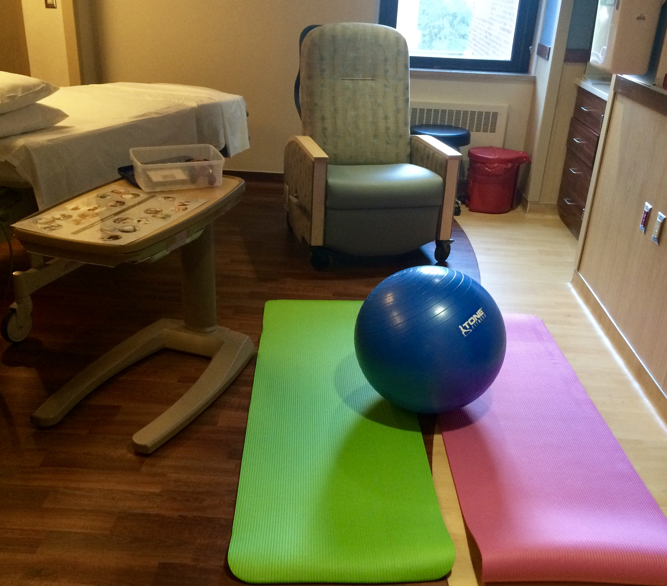
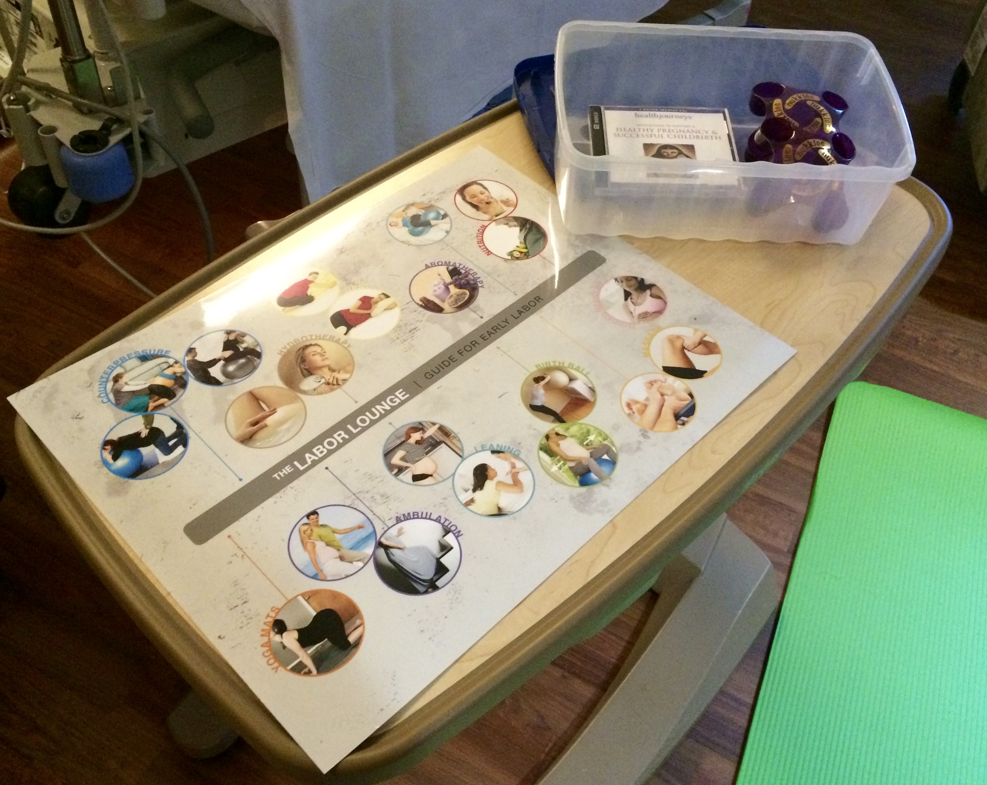
It may be challenging to determine which women have contractions that are regular and strong enough to make cervical change that should be admitted to an inpatient status versus determining which patients would benefit from more labor at home.
Encouraging ambulation, upright positions, hydrotherapy, aromatherapy, massage, relaxation, and hydration can help to provide skills to patients in early labor

Slide 8
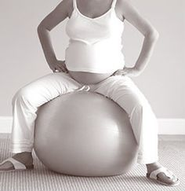
Why create a “Labor Lounge”?
Space to promote maternal position changes
Privacy
Away from medical equipment
Allow for spontaneous self comforting behaviors

Slide 9
Who can use the “Labor Lounge”?
Outpatient status- must be seen by provider
Reactive NST in triage
37-42 Weeks Gestation
Intact membranes
**Patients who would be allowed to ambulate prior to a 2 hour cervical recheck may be offered use of the “labor lounge”**
Exclusion Criteria: women requiring continuous monitoring, IV fluids, or inpatient admission orders
TOLAC
SROM

Slide 10
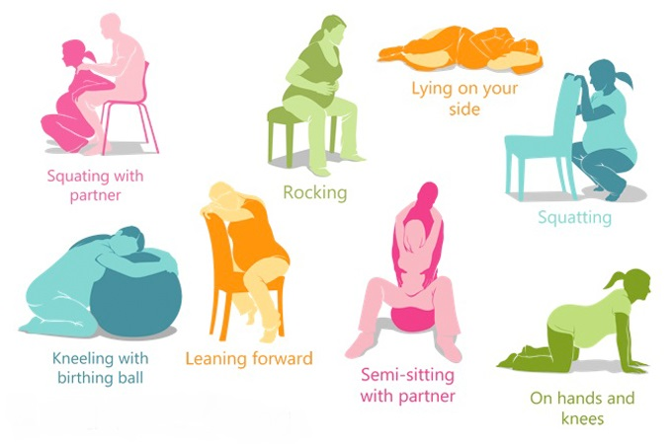
Where is the “Labor Lounge”?
Room 454 can be set up as a “labor lounge”
Supplies available in 454:
Birth balls
Yoga mats
Essential oils
Shower supplies
Encourage hydration and snacks
Guided meditation/music
Miller, R. L., & Swensson, 2002; Seaman, B., & Eldridge, 2012

Slide 11
What is my role?
Starting June 1st, all women who remain outpatient for rule out labor will be encouraged to use the “labor lounge” after a reactive NST, prior to a two hour cervical recheck
Discuss comfort measures, encourage hydration & nutrition, and educate patients about how to use the space
Reassure patients that early/latent labor is normal

Slide 12
Outcome Goals
Patients discharged after two hours will gain confidence and skills to cope with labor at home
“Labor lounge” will promote physiologic labor
Decreasing early labor admissions may decrease the chain of interventions that includes augmentation and cesarean sections

Slide 13
References
Barnett, C., Hundley, V., Cheyne, H., & Kane, F. (2008). 'Not in labour': Impact of sending women home in the latent phase. British Journal of Midwifery, 16(3).
Cheyne, H., Terry, R., Niven, C., Dowding, D., Hundley, V., & McNamee, P. (2007). Should I come in now?’: A study of women’s early labour experiences. British Journal of Midwifery, 15(10), 604-609.
Hosek, C., Faucher, M. A., Lankford, J., & Alexander, J. (2014). Perceptions of care in women sent home in latent labor. MCN: The American Journal of Maternal/Child Nursing, 39(2), 115-121. doi: 10.1097/NMC.0000000000000015
Lauzon, L., & Hodnett, E. (2001). Labour assessment programs to delay admission to labour wards. Cochrane Database Syst Rev, 3(3). doi: 10.1002/14651858.CD000936
Miller, R. L., & Swensson, E. S. (2002). Hospital and healthcare facility design. WW Norton & Company.
Neal, J. L., Lamp, J. M., Buck, J. S., Lowe, N. K., Gillespie, S. L., & Ryan, S. L. (2014). Outcomes of Nulliparous Women with Spontaneous Labor Onset Admitted to Hospitals in Pre-active versus Active Labor. Journal of Midwifery & Women’s Health, 59(1), 28–34. http://doi.org/10.1111/jmwh.12160

